Slide 1
DATA DRIVEN ANALYTICS
To enhance customers, products & sales strategies.

Slide 2
Project Objectives
The goal of this project is to analyze our car dataset to uncover trends and insights.
Analyze the car sales database to support decision-making in customer
relationship management, operational efficiency, and cost optimization.
Apply analytical skills from previous sprints to enhance product development, procurement, marketing, and sales strategies.
Optimize inventory management based on data-driven insights.
Utilize MySQL for data analysis as per project requirements.
Understand customer behavior and improve product management efficiency.
Summarize key findings from the analysis for strategic planning.

Slide 3
CUSTOMER DATA ANALYSIS
EMPLOYEE DATA ANALYSIS
OFFICE DATA ANALYSIS
MODEL CARS DATA Analysis
ORDER ANALYSIS
PRODUCT DATA ANALYSIS
SUMMARY & CONCLUSION Activate WINDOWS
Project
Analysis

Slide 4
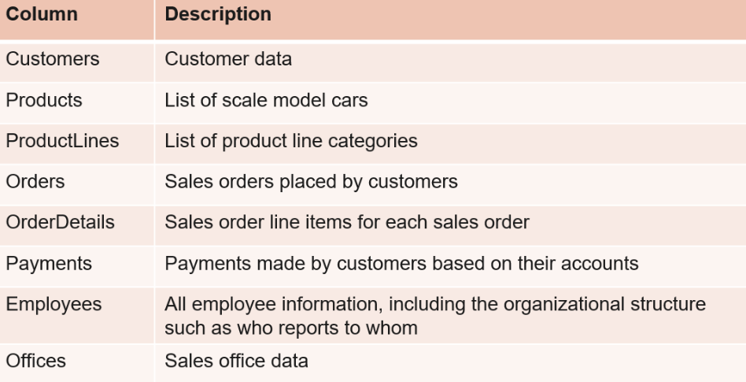
TABLE OF CONTENTS
01
02
03
04
05
06
Section
Section
Section
Section
Section
Section

Slide 5
Queries
SELECT customerNumber, contactFirstName, contactLastName,
creditLimit FROM customers
ORDER BY creditLimit DESC
LIMIT 10;
1. Find the top 10 customers by credit limit.
2. Find the average credit limit for customers in each country.
select country, AVG(creditLimit) AS avg_credit_limit
FROM customers
GROUP BY country;
3. Find the number of customers in each state.
select state, count( * ) AS number_of_customers From customers
group by state;
4. Find the customers who haven't placed any orders.
SELECT customerNumber, contactFirstName, contactLastName
FROM customers
WHERE customerNumber NOT IN (SELECT customerNumber FROM orders);

Slide 6
Customer Data Analysis.
Analysed targeted marketing campaigns or special offers.
Analysed performance evaluation and customer relationship management.
Analysed payment trends and identify potential credit issues.
Customer Segmentation Top Spenders Customer concentration
Customer Engagement Inactive Customers
Customer Relationships Payment History Credit Risks
Product Preferences

Slide 7
Product Data Analysis
Product Distribution by Line
Most Profitable Line
Inventory Management
Most Expensive Products
Sales by Product Line
Top Selling Products
Product Performance
Popular Products
Product Portfolio

Slide 8
HERE ARE Product Portfolio & Performance
1. Number of Products in Each Product Line
SELECT productLine, COUNT(productCode) AS no_of_products FROM products GROUP BY productLine;
2. Retrieve the Most Expensive Products Based on MSRP
SELECT productCode, productName, MSRP FROM products ORDER BY MSRP DESC LIMIT 10;
3. Total Sales for Each Product
SELECT p.productCode, p.productName, SUM(od.quantityOrdered * od.priceEach) AS total_sales_amount FROM products p JOIN orderdetails od ON p.productCode = od.productCode JOIN orders o ON od.orderNumber = o.orderNumber JOIN customers c ON o.customerNumber = c.customerNumber JOIN payments pay ON c.customerNumber = pay.customerNumber GROUP BY p.productCode, p.productName;

Slide 9
Office Data Analysis
Office Data Analysis Number of employees working in each office select officeCode, count(employeenumber) as no_of_employees from employees group by officeCode;
This can be used to know the employee count in each office.
Employee Distribution
Office Locations
find the number of offices in each country select country, count(officecode) as no_of_offices from officesgroup by country;
This can be used to know the offices count in each country.
find the avg credit limit for customers in each office select offices.officecode, avg(creditlimit) as avg_creditlimit_for_customer
from customers join employees on customers.salesRepEmployeeNumber = employees employeenumber join offices on employees.officecode = offices.officecodegroup
by officecode; Customers average credit limit in each office

Slide 10
Employee Distribution
Employee Count by Office
Understaffed Offices
Offices with No Employees
Largest Office
Most Profitable Office
Office Locations
Offices by Territory
Offices by Country

Slide 11
Order Analysis
Number of orders placed in each month
select monthname(orderdate) as Month, count(ordernumber)
as no_of_orders from orders group by_month;
Maximun number of orders are placed in month of November and minimum orders are placed in August.
highest-value order based on total sales
select orders.orderNumber, sum(quantityordered priceeach) as total sales from orders join orderdetails on orders.ordernumber = orderdetails.orderNumber group by orders.ordernumber order by total_sales desc limit 5;
Most frequently ordered products
SELECT p.productCode, p.productName, COUNT(*) AS total_ordersFROM orderdetails od INNER JOIN orders o ON od.orderNumber = o.orderNumberINNER JOIN products p ON od.productCode = p.productCode GROUP BY p.productCode, p.productName ORDER BY total_orders DESC limit 20;
1992 Ferrari 360 Spider red' is Most Frequently Orders Product followed by other products

Slide 12
Employee Data Analysis.
Total Number of Employees
select count(employeenumber) as Total_no_of_Employees from employees; There are total 23 Employees in Employees data.
Total Sales generated by each sales representative
SELECT e employeeNumber, CONCAT(e.firstName,, e.lastName) AS sales_representative, SUM(od.quantityOrdered od.priceEach) AS total_sales FROM employees e
JOIN customers c ON e.employeeNumber = c.salesRepEmployee Number JOIN orders o ON c.customerNumber = o.customerNumberJOIN orderdetails od ON o.orderNumber = od.orderNumber where jobtitle = 'sales Rep' GROUP BY e.employeeNumber, sales_representativeORDER BY total_sales DESC;
This query returns total Sales generated by each sales representative, Gerard Hernandez is a sales representative topped the total sales with $1258577.81, followed by all employees.
Sales representative with highest no.of customers
select CONCAT(firstName, lastName) AS sales_representative,count(customernumber) as total_cust from customers join employees on customers salesRepEmployeeNumber = employees.employeeNumber
group by employeenumber, sales_representative order by total cust desc,
Pamela Castillo is Sales Representative with highest no. of Customers, i.e. 10 customers

Slide 13
OUTCOMES 1. Employee Count and Details 2. Employee Roles 3. Sales Performance 4. Top Performers

Slide 14
Customer Segmentation and Targeting:
Identify high-value customers based on credit limit, sales, and purchase history (Top Customers, Sales Performance, Product Preferences).
Customize marketing campaigns and offers for different customer segments based on demographics, location, and behavior.
Re-engage inactive customers with targeted campaigns.
Sales and Relationship Management:
Improve territory management by assigning sales reps effectively and using customer location data (Customer Distribution, Sales Rep Management).
Track payment history to spot potential credit risks and take proactive measures (Payment History, Credit Risks).
Monitor sales rep performance, recognize top performers, and provide incentives (Sales Rep Performance, Top Performer).
Business Conclusions from Office Data Analysis:
Optimize staffing across offices based on employee count and performance (Staffing Levels, Understaffed Offices, Largest Office).
Identify high-performing offices and allocate resources effectively (Profitability).
Analyze credit limits by office to understand regional spending (Credit Analysis).
Consolidate or restructure offices with no assigned employees (Inactive Offices).

Slide 15
Product Portfolio Management:
Evaluate product profitability and find upselling opportunities (Profitable Lines, Sales by Line).
Keep inventory levels optimal by restocking low stock products (Inventory Control).
Develop targeted marketing for premium and top-selling products (Premium Products, Top Selling Products).
Study successful products to replicate their success across the portfolio.
Sales Enablement and Performance Management:
Identify skill gaps and training needs (Job Titles).
Ensure clear management structure with designated managers (Management Structure).
Reward top-performing sales reps (Top Performer).
Motivate employees who exceed average sales in their offices (Above Average Performers).
Customer Behavior and Sales Optimization:
Analyze order trends to plan inventory and marketing (Order Trends).
Find upselling and cross-selling opportunities with popular product combinations (Popular Products, Product Combinations).
Implement triggers to adjust credit limits after purchases (Credit Limit Trigger).
Track product quantity changes for accurate inventory (Product Quantity Log Trigger).
Analyze delayed shipments to fix bottlenecks in the fulfillment process.

